Slide 1
Repurchase in 3 Days Forecast
ÇİYA BARAN ÖNER

Slide 2
TABLE OF CONTENTS
INTRODUCTION AND PROJECT PURPOSE
PROJECT DESCRIPTION, PROJECT PURPOSE
DATA ANALYSIS
MODELING APPROACH
CONCLUSIONS AND TAKEAWAYS

Slide 3
INTRODUCTION AND PROJECT PURPOSE
Project Description: This project includes user-level models (Random Forest, Logistic Regression, XGBoost, LSTM) that predict that there will be no new purchases within 3 days from the moment of the last purchase using purchase data. Due to the instability of the data, machine learning algorithms have not been able to produce good results. LSTM model, which learns sequential data well; Despite the instability of the data, it constantly produces better results with parameter improvements. This shows that the model can be improved.
Purpose of the Project: It aims to develop a user-level model to predict purchasing behavior over 3 days after the last available purchase data.

Slide 4
DATA ANALYSIS – Data Exploration
This stage involves the discovery of data. It allows us to find the relationship between the metrics, the differences in difficulty between the levels, the relationships between the data sets and the features required for our model.

Slide 5

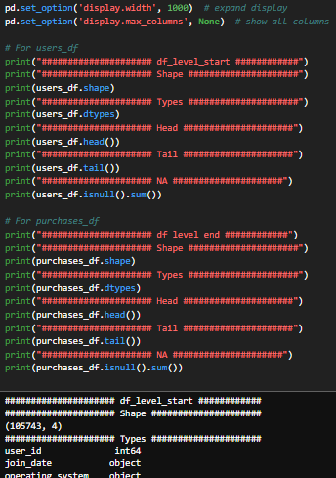
Selecting and uploading data sets that will be useful.
A pre-inspection step of each dataframe.
It includes steps such as learning the types of data, examining the number of data, examining the columns in the data and Null data control.

Slide 6

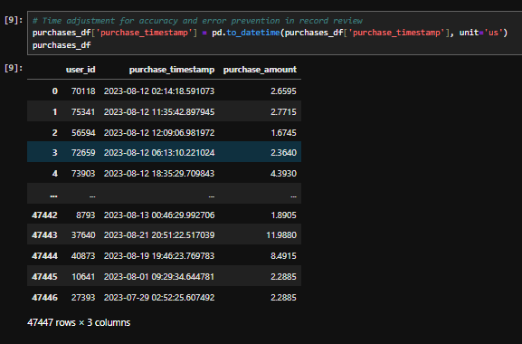
The number of unique players that triggered the purchase event.
Time changes both to increase the comprehensibility of the data while examining it and to make time-related operations.

Slide 7
DATA ANALYSIS – Data Manipulation and Feature Engineering
This stage includes the separation of unnecessary data in the datasets and the removal of distorted metrics.
At this stage, it also includes creating new metrics, merging data sets, and data transformations.
Handling missing data and quantifying categorical variables are also included in this stage.

Slide 8
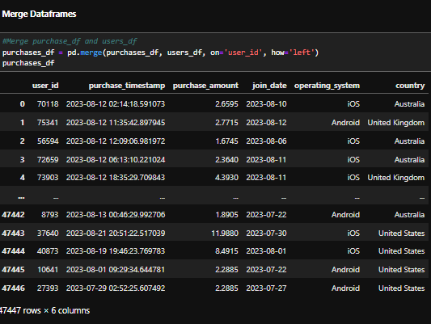
Merging of Data
Merging two datasets.

Slide 9
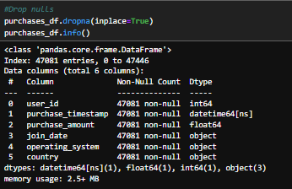
Deletion of Null Data

Slide 10
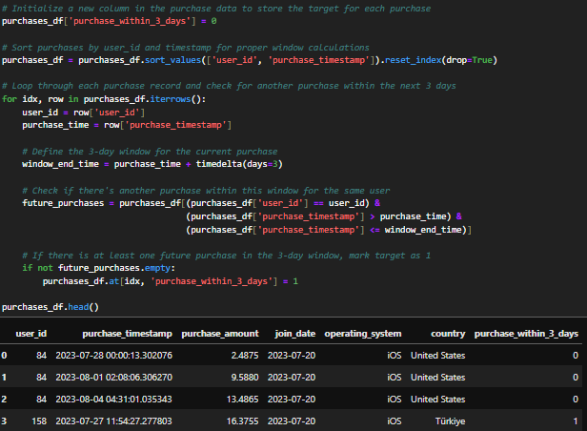
Creation of the target variable; repurchase within 3 days of the last purchase date;
If any: 1 Otherwise:0 Assigns variables.

Slide 11
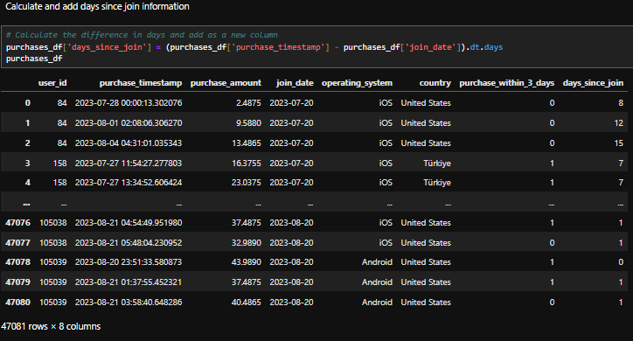
Calculation of the Number of Days From the Date of Registration

Slide 12
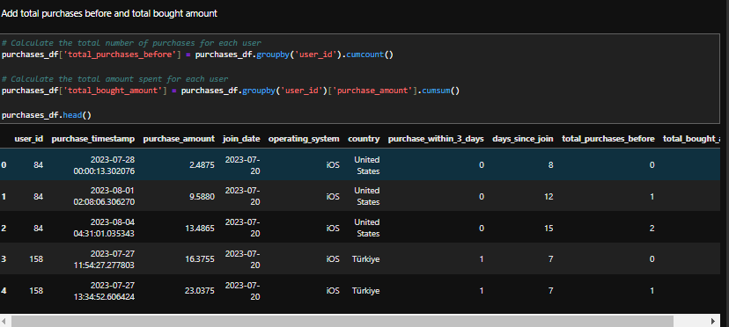
Calculate Total Number of Purchases and Total Purchase Amount
Total_purchases_before: Starting from 0 and continuing increasingly. 0 refers to the first purchase. It represents the total number of purchases.
Total_bought_amount: Holds the user's total amount spent up to and including that point.

Slide 13
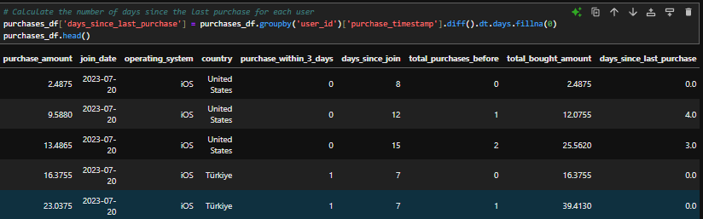
Calculation of the day difference between the last sale and purchase
Days_since_last_purchase: How many days before this purchase did the last purchase take place. If there are no purchases before moment, it takes 0.

Slide 14
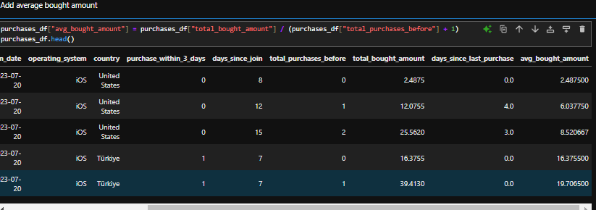
Calculate Average Purchase Amount
Avg_bought_amount: This information is found by the total purchase amount / total number of purchases.

Slide 15
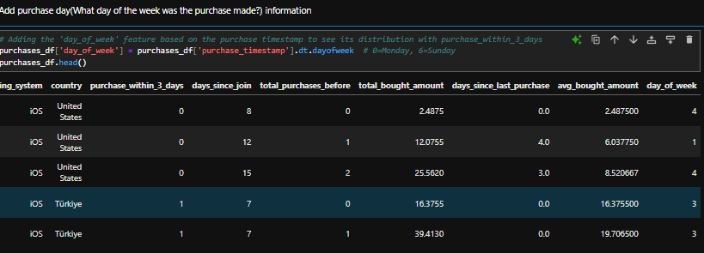
Addition of Purchase Day
Day_of_week: It gives information on which day of the week the purchase was made.
Monday:0
Sunday:6

Slide 16
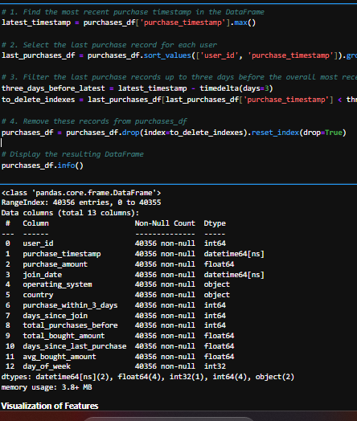
Removal of Ambiguous Data
It is the process of deleting small data 3 days before the last day of registration in the last purchases. Because the outcome of these latest records is still uncertain.
The 0 value is already small in dataset, this will cause the 0s to be learned incorrectly. Because the last record of each user is always 0. However, 0's that have not yet been determined and have not yet completed the day should be deleted.

Slide 17
Data Visualization
At this stage, there is a visualization of the metrics in the last processed purchase_df obtained.
The goal is to understand metrics and user movements.
It also includes examining the values of the metrics.

Slide 18
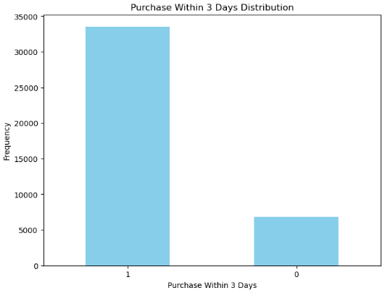
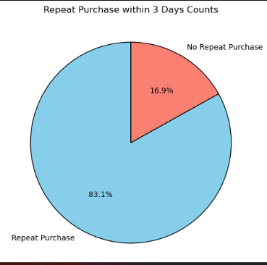
Target variable distribution(%)
Target variable distribution
As we can see, we have an unbalanced dataset. This should be taken into account when training the model

Slide 19
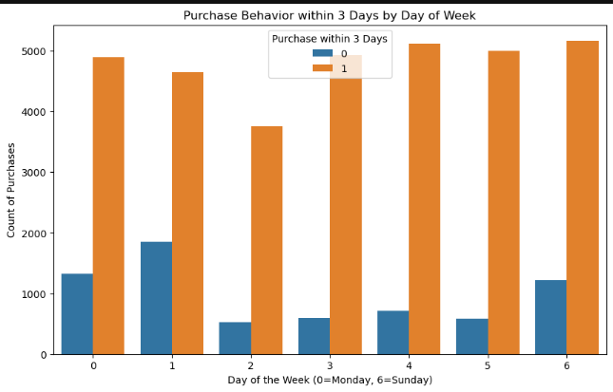
Chart showing how the days of the week relate to a repurchase within 3 days.

Slide 20
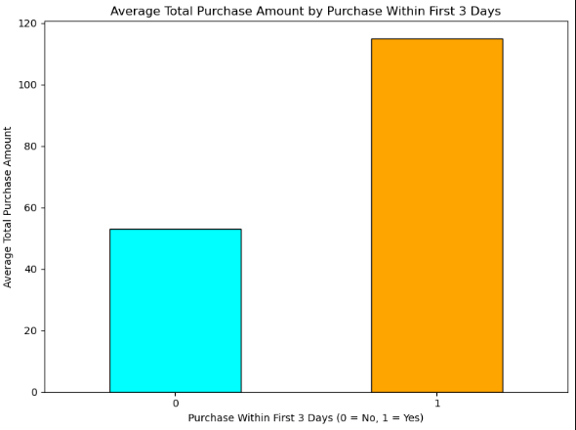
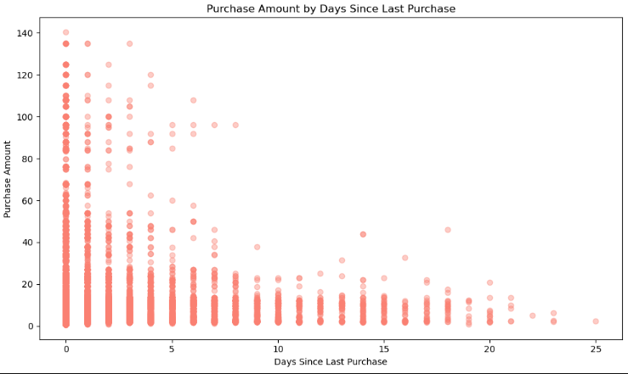
The relationship between the total amount of purchases and the target metric.
Relationship between purchase quantity and purchase gap

Slide 21
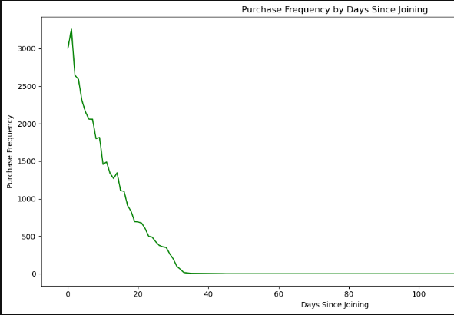
In the charts, behaviors related to the target metric and purchase were detected. The relevant metrics will be used in the model.
A graph that gives the relationship between the frequency of purchases and the number of days they are registered.

Slide 22
MODELING APPROACH
Machine learning algorithms have not performed very well because we have unbalanced data.
Algorithms such as RandomizedSearchCV, GridSearchCV to find the best parameters and approaches such as SMOTE were used to prevent data imbalance to increase model performance
In this step, first Random Forest, then Logistic Regression and then XGBoost models were used. Finally, LSTM was used.

Slide 23
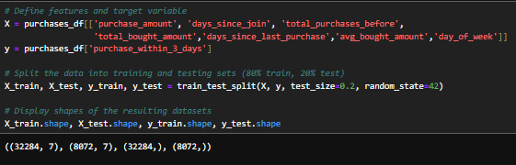
Creation of Training and Test Data

Slide 24
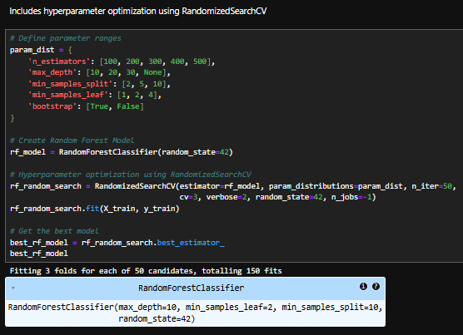
Random Forest- Detection of the Best Parameters (RandomizedSearchCV)

Slide 25
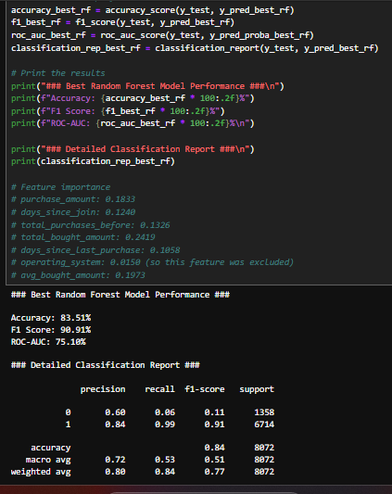
Random Forest Model Test Results
Result: As we can see, the recall value is extremely low. However, the precision value is high because there is an extreme imbalance in the data and it constantly makes biased predictions. Therefore, the F1 score does not mean anything.
The operating system and country information were omitted in order not to increase the complexity in the previous model training results and because the random tree algorithm was low in the order of feature importance and the machine already had difficulty learning (due to data imbalance).

Slide 26
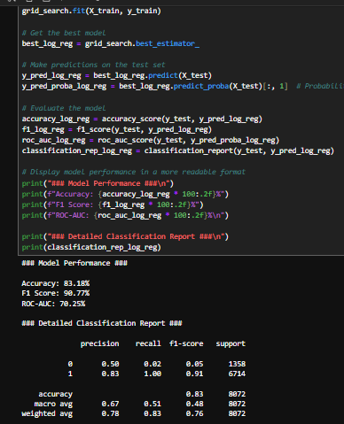
Logistic Regression Model Test Results
Result: As can be seen, the recall value is extremely low. However, the precision value is high because there is an extreme imbalance in the data and it constantly makes biased predictions. Therefore, the F1 score does not mean anything.

Slide 27
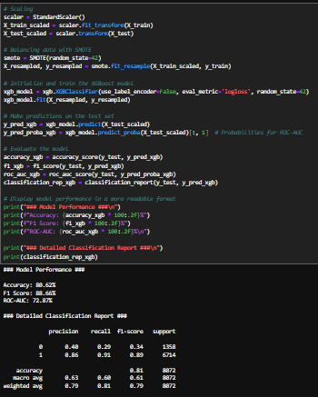
XGBoost Model Test Results
Result: This model can produce better results than others. Because it can make better sense of complex data. With SMOTE, data imbalance was tried to be tolerated, data was reduced, but very good results were not obtained.
Note: The results were better than this last result, but still not satisfactory.

Slide 28
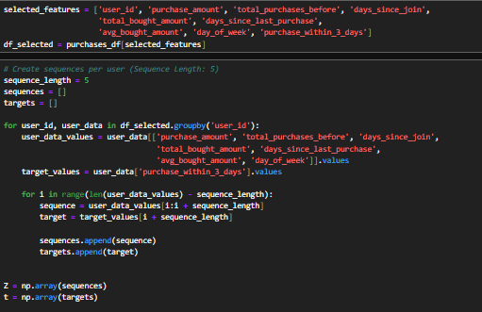
LSTM Model Setup
-Training and test data were recreated sequentially and in 3D.
- Data sorted on a per-user basis, and each user's sequential purchase records feed the LSTM model with a sequence_length length of 5.

Slide 29
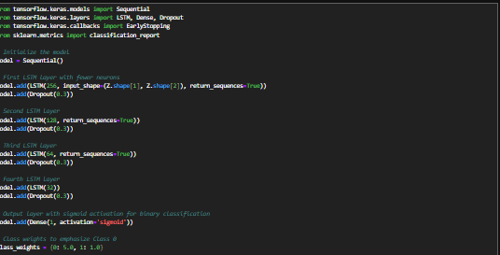
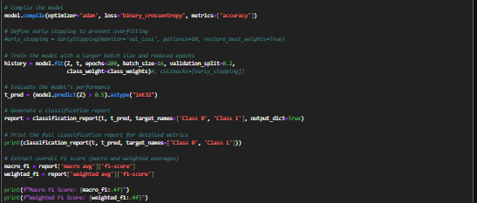
LSTM Model Setup
The most important point here was the preferred values in determining the class weights. Between 4-5, generally good results were obtained.
The LSTM model with these parameters produced satisfactory results. This is a sign that the improvements will increase even more with the hyperparameter.

Slide 30
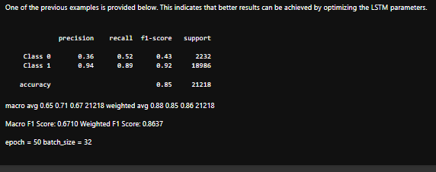
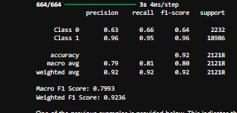
LSTM TEST AND RESULT
LSTM experiment with different parameters
Conclusion of the final model
RESULT:
With these results, it was seen that the LSTM model could be successful in this dataset. The results obtained with the optimizations made after the low results obtained with different parameters were improved. This indicates that the model will perform better.

